Slide 1
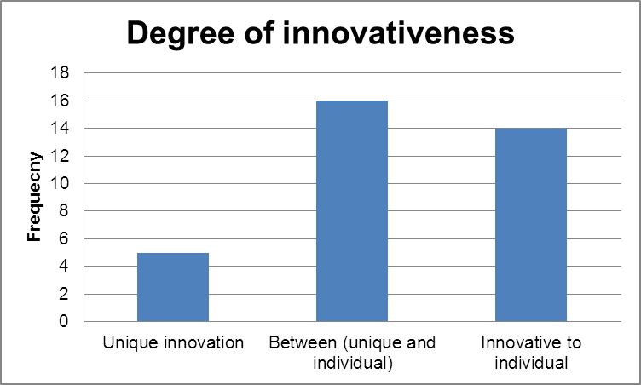
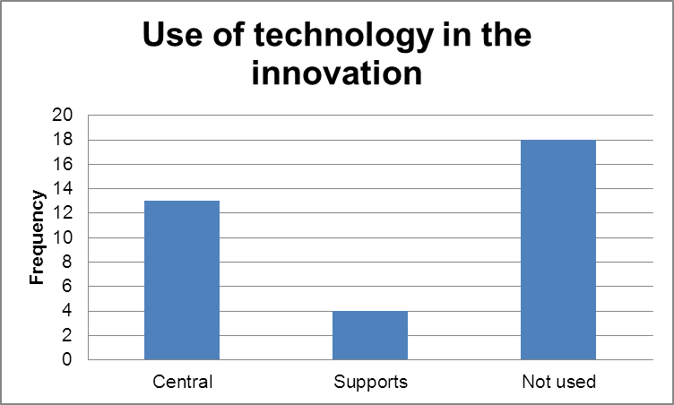
Developing innovative practice in student teachers
Peter Gossman and Sue Horder, Glyndŵr University, Wales
Acknowledgments AUT - CEPD
Template by Julia Hallas and Rich Carthew
Introduction
Literature
Module Rationale
Case Studies
Case Studies
This research examines the effectiveness of a module in a PGCE (PcET) programme entitled ‘Innovation and the Teacher’. The module aims to promote innovation in both generic and subject specific pedagogies. It also endeavours to share best practice by means of a written case study that is disseminated via an exposition.
There is a requirement, in our view, in initial teacher training (ITT) for the tutors of the programmes to model best practice. Thomas and Pring (2004) note that modelling such practice is a key factor in influencing and encouraging student teachers to develop, taking account of experiences and new knowledge.
As ITT teachers we aim to be innovative and creative in our work, thereby requiring (via modelling) student teachers to challenge and develop their own teaching. We suggest that student teachers, by being challenged to undertake an innovative approach, at an appropriate stage in our programme, can increase and deepen their skills. The challenge is ‘would more learning take place if you taught differently?’ Students begin to answer this question by considering their own learning in the ITT sessions.
The subsequent challenge is for them to be creative and innovative in a session(s) of their own.
It is taken as a basic premise that all students possess creative capacities (Robinson, 2001), and that it is finding their cognisant ‘element’ or ‘flow’ (p.11) that will allow them to utilise their creative thoughts to produce innovative actions which may enhance their teaching style.
However, there are initial barriers to overcome with Mann (2001, p.13) making clear the alienation of creativity in students created by learning and power relationships in higher education. It is therefore argued that the first task of the ITT teacher is to guide students towards a positive appraisal of their perception of creativity and innovation. This is achieved through pro-active sessions introducing personal and professional characteristics of role models in their lives - the transformational mentor (Sternberg, 2002), a history of creative cultures - the rise of innovation as a distinct cultural value, (Negus and Pickering, 2004) and an examination of innovators’ creative processes (Vernon,1970).
Learning activities that emphasise; branching out, divergent thinking and discovery learning can be more effective than traditional methods such as face to face lecturing (Cropley, 2001, p16).
The innovation module challenges student teachers to test new solutions (innovations) in teaching and learning. These are formally evaluated through a written case study.
Innovation in teaching and learning has a significant focus within the PGCE (PcET) programme at Glyndŵr University and as a result the ‘Innovation and the Teacher’ module has a 50% weighting on Phase 2 of the programme.
The first part of the assessment includes an observation of their innovative approach within their session by their PGCE tutor or mentor within their placement organisation. For the second part, students are required to critically evaluate within a written case study, their innovative approach. The innovation is creative but draws on theoretical literature to inform practice. The case study is then, reflexive in nature.
The case studies are put together as an in -house publication and the students celebrate with an exposition in June where all learners from Glyndŵr and it’s franchise partner institutions share their innovation projects. This student conference promotes the sharing and discussion of teaching practice and we hope enhances a collegial approach to professional development.
The module encourages students to explore;
Creativity in planning
Creativity in action
Opportunities for their own students to be creative.
The written case study, is credible evidence that new approaches can enhance students learning.
Included here are a few examples of the work generated by the students undertaking this module.
Student A: A new teacher of AS –Level Law.
Role play and mock trials.
A new experience for the students and a way of bringing the subject content to life. Innovative to the student because she had not tried it in her teaching before. Evaluation reports higher level of student engagement with the content of the session.
Student B: A new teacher of AS-Level Business Studies.
Self assessment as a tool for producing a personalised revision guide.
Students reviewed results from an assessment and identified areas for improvement. These were discussed with their peers and an individual revision guide for exam preparation was created. Students were empowered to assess their own work and make decisions about their own development.
Student C: A new teacher of A2 Religious Studies.
‘Ghost Hunting’ field trip.
An idea focusing on the experience the students had on a field trip – a ghost walk run by a tourism company. Students related their experiences to modules in their programme of study. An unusual approach to the subject content.
Student D: A new teacher of NVQ Heath and Social Care.
Music genres as a stimulus for making judgements about types of listeners.
The session used a range of music to illustrate how we make judgements about the ‘type’ of people that normally listen to music from that genre. Discussion then focused on the ‘stereotyping’ that takes place in response to different stimulus. Evaluation reported that the message of ‘stereotyping’ was learnt via the approach adopted.
Student E: A new teacher of BTEC Media Studies.
Video diaries as a tool for reflection during the production of project work.
Students used a ‘big brother’ style private recording space to compile a video diary of their reflective thoughts on the production process for a media studies project. Students engaged with the use of media in a media course to produce candid and developmental reflections on their projects.
Student F: A new teacher of Art
Audio recording of tutorials to capture discussion and subsequently generate a more detailed action plan.
Art tutorials were recorded to provide the students with material that they could re-listen to and reflect upon in order to generate a detailed action plan. Enjoyable and highly productive innovation.
Methodology
Analysis and Results
The data collection for this small-scale study is drawn from a number of student case studies (n=35) analysed against a set of criteria developed from Cropley’s (2001) work in Creativity in Education. A sample of the case studies were read and then codings agreed between the two researchers. Using a grading system the written case studies were analysed against the following criteria:
Use of technology (1-central to project, 2-supports the innovation, 3-not utilised)
Degree of innovativeness (1-unique, 2- in between, 3-innovative to individual)
Originality (Only commented on if scored 1 or 2 in degree of innovativeness)
Complexity and completeness of answer (1-very uncommon solution to issue, 2-uncommon, 3-common solution)
Effectiveness (1-very effective solution developed, 2-effective solution, 3-partially effective, 4-ineffective)
The data was tested (chi squared test) for its significance and the results can be seen opposite.
References
This small-scale study has examined the effectiveness of the ‘Innovation and the Teacher’ module undertaken as part of a PGCE (PcET) programme.
Chi squared tests were conducted on the data (n=35) for the following null hypotheses:
H_{o} No statistical relationship existed between x and y
Subject taught (Biglan (1973) categories) and the use of technology (accept H_{o} - no relationship)
Subject taught and the degree of innovation (reject H_{o} - statistical relationship) *
Subject taught and originality (accept H_{o} - no relationship)
Subject taught and the effectiveness of the idea (reject H_{o} statistical relationship)*
Use of technology and the degree of innovativeness (accept H_{o} - no relationship)
Use of technology and originality (reject H_{o} - statistical relationship) *
Use of technology and the effectiveness of the idea (accept H_{o} - no relationship)
Degree of innovativeness and originality (reject H_{o} - statistical relationship)
Degree of innovativeness and the effectiveness of the idea (reject H_{o} - statistical relationship)*
Originality and the effectiveness of the idea (reject H_{o} statistical relationship)
The results from the study suggest that these aspect of our codings are related; subject taught and degree of innovation, subject taught and effectiveness of the innovation, use of technology and originality, degree of innovativeness and effectiveness.
We hope to explore the possible nature of these relationships in further work.
Biglan, A. J. (1973) The characteristics of subject matter in different academic areas,’ Journal of Applied Psychology 57:195–203.
Cropley, A.J., (2001) Creativity in Education and Teaching, Great Britain: Kogan Page
Mann, S. (2001) Alternative Perspectives on Student Experience: alienation and engagement, Studies in Higher Education, 26(1): 7-19.
Negus, J & Pickering, M, (2004) Creativity, Communication and Cultural Value, London: Sage.
Robinson, K. (2001) Out of Our Minds, Oxford: Capstone Publishing Ltd.
Sternberg, R.J., (2002), The Teachers We Never Forget, APA Monitor, 33(8),68
Thomas, G. and Pring, R. (Eds.) (2004), Evidence-based Practice in Education. Maidenhead: Open university press.
Vernon, P.E. (1970) Creativity, London: Penguin Books

