Slide 1
Professional learning and leadership: An international resource for the art, craft, and science of disciplinary literacy acquisition and instruction
Enrique A. Puig, Sandra L. Robinson, Michael A. Grego, Gillian I. Eriksson
2011 International Council on Education for Teaching World Assembly

Slide 2
Session objectives:
Immerse literacy educators in breakthrough resources in research and appropriate instructional practices
Provide on-line high quality materials, programs, and professional learning opportunities
Engage university-based research scholars and school-based practitioner scholars in dialogic conversations
Employ technology to disseminate and collect information
Respond in a timely manner to ensure professional learning
Demonstrate materials and access to models of appropriate instructional practices

Slide 3
Presenters and point of view:
Enrique A. Puig – theoretical foundation
Sandra L. Robinson – historical perspective
Michael L. Grego – educational leadership
Gillian I. Eriksson – diverse populations

Slide 4
Theoretical foundation:
Literacy learning is complex (Clay, 2001)
Literacy enterprises are an aesthetic as well as an efferent endeavor (Rosenblatt, 1978)
Knowledge is socially constructed (Vygotsky, 1978)
Attention, motivation, and situation need to be in harmony for learning to be productive (Csíkszentmihályi, 1997)
Opposing views are seen as strengths rather than hurdles towards seeking solutions (Bakhtin, 1981)
Adult learning is a solution-seeking endeavor (Knowles, 1984)
Universal conditions of learning need to be in place for optimal literacy learning to occur (Cambourne, 1988)

Slide 5
University-based research scholar/
School-based practitioner scholar
Florida Literacy and International Reading (FLaIR) Fellows
International Collaborative Partnerships
International Society for the Social Studies
Florida Literacy Coaches association
Pre-K – 12 Classroom Teachers

Slide 7
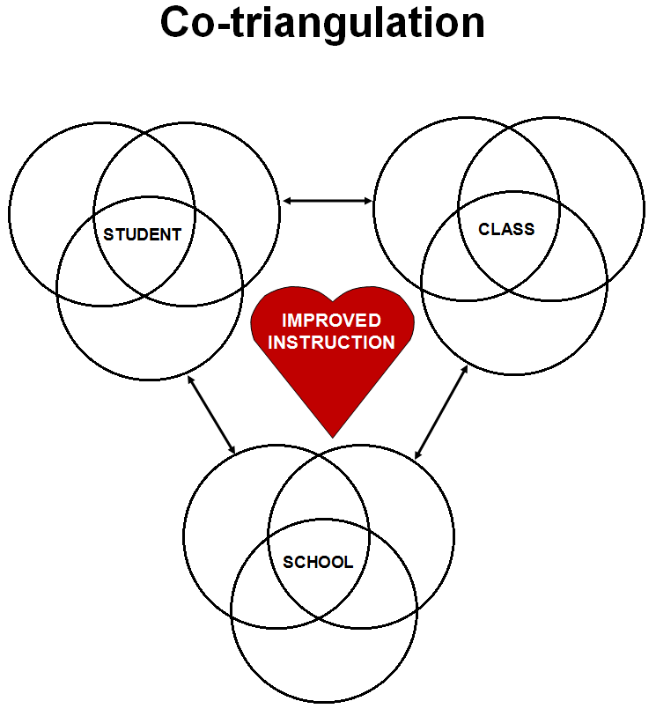
Literacy coaching from an ethnographic perspective

Slide 8
Critical role of developing a common language in a professional learning community
Improves communication and allows for better interpretation of data
Expands thinking by applying new concepts to known words
Economizes on time when meeting to discuss adaptive challenges
Develops a sense of community
Creates a safe environment
The Literacy Leadership Team: Sustaining and Expanding Success. Froelich, K.S. & Puig, E.A. (2010)

Slide 9
Sandra L. Robinson
International need for the Morgridge International Reading Center
Importance of a cohesive instructional PK – 20 plan
Notes:
Transition slide to introduce next speaker

Slide 10
An international resource to support the professional learning and leadership necessary to sustain and expand success in schools
Sandra L. Robinson

Slide 11
A historical perspective for the need of the Morgridge International Reading Center
Location
X
Notes:
The Morgridge International Reading Center is located at the University of Central Florida in Orlando. The University of Central Florida is the second largest university in the United States and the largest university in the state of Florida. Current enrollment for the Fall 2010 term exceeded 56,000 students taught by over 1700 faculty members. The main campus in Orlando is on 1,415 acres. The university provides 183 bachelor’s and master’s degrees, and 29 doctoral programs. Students come from all 50 states in the United States and 140 countries. With the main campus housed in Orlando, Florida, where there are approximately 132 languages and dialects spoken, UCF is a prime location for the Morgridge International Reading Center.

Slide 12
A generous gift . . .
Morgridge Family Foundation
Notes:
The Morgridge Family Foundation is a private foundation whose vision is to become leaders in venture philanthropy so that the neediest of the needy will have greater opportunities to receive quality education. The foundation also supports several early childhood literacy and health initiatives.

Slide 13
Purpose…
Collect and disseminate educational information based on innovative research.
House a comprehensive collection of global reading initiatives.
Serve as a hub of connectivity.
Provide opportunities for professional learning.

Slide 14
Holistic PK-20 education
A holistic PK-20 education consolidates established and proven educational practices with current resources and future needs. The creation of a cohesive PK-20 system will better prepare students for the jobs of the 21st century.

Slide 15
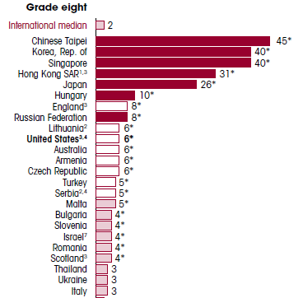
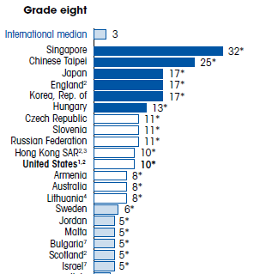
Trends in International Mathematics and Science Study - TIMSS
Notes:
Sample of percentage of eighth-grade students who reached the TIMSS advanced international benchmark in mathematics and science, by country: 2007

Slide 16
Progress in International Reading Literacy Study PIRLS
General findings:
• The Russian Federation, Hong Kong SAR, and Singapore were the three top-performing countries.
• Participants with the highest average achievement overall, also tended to have the highest average achievement for literary
and informational reading and for the comprehension processes.
• Girls had significantly higher reading achievement than boys in all except two countries (Luxembourg and Spain).
• For about half the participants, almost all of their students demonstrated at least some basic reading competencies.
• In about half of the participants, almost all students reached the Low International Benchmark.
• In about half of the participants, three fourths of the students reached the Intermediate Benchmark and about two fifths reached the High Benchmark.
• Singapore and the Russian Federation had the greatest percentages of high-achieving students, with about 19% reaching the Advanced Benchmark.

Slide 17
The importance of a cohesive instructional plan for PK-20
Cooperation among educational levels has to be in place in order to equip and prepare students.
A cohesive PK-20 instructional plan identifies strengths and scaffolds students to ensure success
Education is the common denominator

Slide 18
Michael A. Grego
Supporting educational leaders in the field of reading
Development of a district- and school-wide comprehensive reading plan
Notes:
Transitions slide to introduce next speaker.

Slide 19
Promoting Literacy in Large Urban School Districts
Michael A. Grego

Slide 20
Characteristics of Large Urban Districts
Tampa-193,000 plus students
Orlando – 150,000 plus students
Osceola – 53,000 plus students- demographics
66 percent free or reduced lunch (poverty)
27 percent English Language Learners (ELL)
High Rate of Mobility – some school over 70%
Homeless epidemic- 1,400 last year
Unemployment and house foreclosures(national high)
Key ingredient for success - Focus on Literacy as the Foundation for All Learning!

Slide 21
Develop a highly prescriptive reading plan based on progressive research and most importantly
WORK the PLAN everyday!
Monitor student progress or lack of progress
Review the Plan Monthly – ask the difficult questions, how are our learning disabled or ELL students doing? How do we know?
Develop Community Reading Programs and involve the community and businesses
Train subject area teachers on teaching effective reading strategies (social studies, science, elective teachers)
Create a culture that is evident at all schools that reading is valued – train all school based and district administrators

Slide 22
c
Building Teacher Capacity
Comprehensive Reading Plan – district wide plan
Implement and monitor plan based on research-based strategies that work, i.e. ESE, ELL, below grade level readers, early childhood education, adolescent reader, after-school programs, home schooling, and the use of technology
Endorse Reading Coaches in all schools
Implement extensive teacher training, summer training and periodic training during school year
Train Reading Coaches Monthly
Time logs, coach all grade level teachers, modeling, formative and summative assessments, progress monitoring of teachers and students

Slide 23
How Can the Morgridge International Reading Center Assist to Increase Student Literacy
Clearinghouse for research-based reading instruction
School District and/or school site reading plans – share, review and critique
Professional Development should be a major portion of any plan (at least 50%)
Building capacity through effective and relevant training for Administrators, Reading Coaches, Teachers, and support staff
On-going monitoring of plan as well as student performance during the school year, no surprises!

Slide 24
Morgridge International Reading Center
Designed to assist school districts (summary):
Provide assistance to increasing student literacy
Customize professional development based on your needs and specific grade levels
Provide on-time and relevant training based on proficiency levels of trainees
Assist in developing literacy plans and monitor progress throughout the school year
Analyze most effective strategies (return-on-investment)

Slide 25
Gillian I. Eriksson
World citizenship
International perspectives
Notes:
Transitions slide to introduce next speaker.

Slide 26
Developing Excellence in Diverse Populations of Highly-Able Students for the 21st century
Gillian I. Eriksson

Slide 27
“From an educational perspective, these students may often be trapped in schools that do not acknowledge the presence of gifted children, that do not offer appropriate level intellectual stimulation and that do not provide the value-added services necessary to encourage talent development.”
(Van Tassel-Baska, 2007).

Slide 28
Central Educational Issues
ABLED GIFTED
Equity and identification of marginalized
Excellence and Creative Productivity
DIVERSE
Cultural Competence
Conflict Resolution and problem solving
GLOBAL
World Citizenship
International Perspectives

Slide 29
Highly-Able/Gifted children At-Risk
"At risk would include gifted children and youth living in poverty or in circumstances of abuse and neglect; children and youth who experience discrimination based on race, language, gender, or sexual orientation; and students from all backgrounds who have experienced trauma”. Kitano, M. (2005)
Florida: 5.8% of 124,491 gifted students were identified using alternative criteria (low SES, ESOL). Local county 22% newly identified gifted were low SES. (OPPAGA, 2006-2007)
Research on gifted dropouts – most low SES, minority, less educated parents, lack of academic goals. (Renzulli & Park, 2000)
Advocacy: Jacob K Javits Gifted and Talented Students Education Act (1988) and the National Research Center on the Gifted and Talented

Slide 30
Recommendations: Implementing programs and services for promising students in poverty
Identification inclusive – Multiple measures to match abilities to program, performance based measures, dynamic and authentic assessments, specialized talents
Interventions – Individual plan with parental involvement – Advanced and high-end learning, enriched courses, tutoring in gaps in content, skills. Ongoing personalized experiences.
Literacies – reading comprehension, critical thinking, literary analysis, creative writing.
Transition services – mentoring by counselors, teachers, tutors, researchers for students and parents
Retention – value added assessment, teacher expectations and academic identity – ongoing collaborations with universities/agencies

Slide 31
Impact of Technology for Underserved Gifted
Access
Mastery Learning and acceleration
Empowers
Cultural relativity - Marginalized groups
Individual abilities, interests, motivations, learning styles
Connected
International links daily
Interactivity
Information and enrichment
Free materials, open source-ware

Slide 32
The role of the learner in the global classroom has transformed from
FIXED
Teacher-directed
FLUID
Individualized constructivist approach
Predetermined
Set content area
asynchronous
Average group centered
scheduled
Fast-changing
Learner-centered
Interactive
TO

Slide 33
Content Knowledge
THIS?
Skim and Scan
Pick and Click
THAT?
Contemplative reading
Copy and paste
Link and LOL
Consensus
Profit driven search engines
Expanded Thought
Creative Thinking
Authentic Connections
Individuals constructing information
Intelligent search engines
OR
Carr, N (2010) The Shallows: What The Internet Is Doing To Our Brains.. New York: W.W. Norton & Company.

Slide 34
New Literacies
CHALLENGE EXCELLENCE
High Expectations
Differentiation
CULTURAL COMPETENCIES
Empathy
Engagement-service
CREATIVE PRODUCTIVITY
Problem-solving
Authentic connections

Slide 35
ACCESS Mastery | BILINGUAL Multilingual English Learners | CONNECTED Virtual Authentic | DIFFERENTIATED Individualized | ENRICHMENT Virtual field trips
FUTURE | GLOBAL | HYPERTEXT Hyperlinks Multitasking | INTERACTIVITY International Intercultural | JOURNEYS Stories Relativity
KNOWLEDGE Constructivist | LITERACIES Best Practices | MULTICULTURAL | NATIONAL | OPPORTUNITY
PRODUCTIVITY Creative programs | QUESTIONING | RESOURCES Clearinghouse Research | STIMULATING Skill development | TRANSCENDING Borders, Time, Space
UNDERSERVED | VIRTUAL Realities Avatars | WORLD OUTREACH | X GENERATION WIRED | YEAR ROUND ZENITH

Slide 36
Questions and Discussion
Enrique A. Puig – theoretical foundation
Sandra L. Robinson – historical perspective
Michael L. Grego – educational leadership
Gillian I. Eriksson – diverse populations

Slide 37
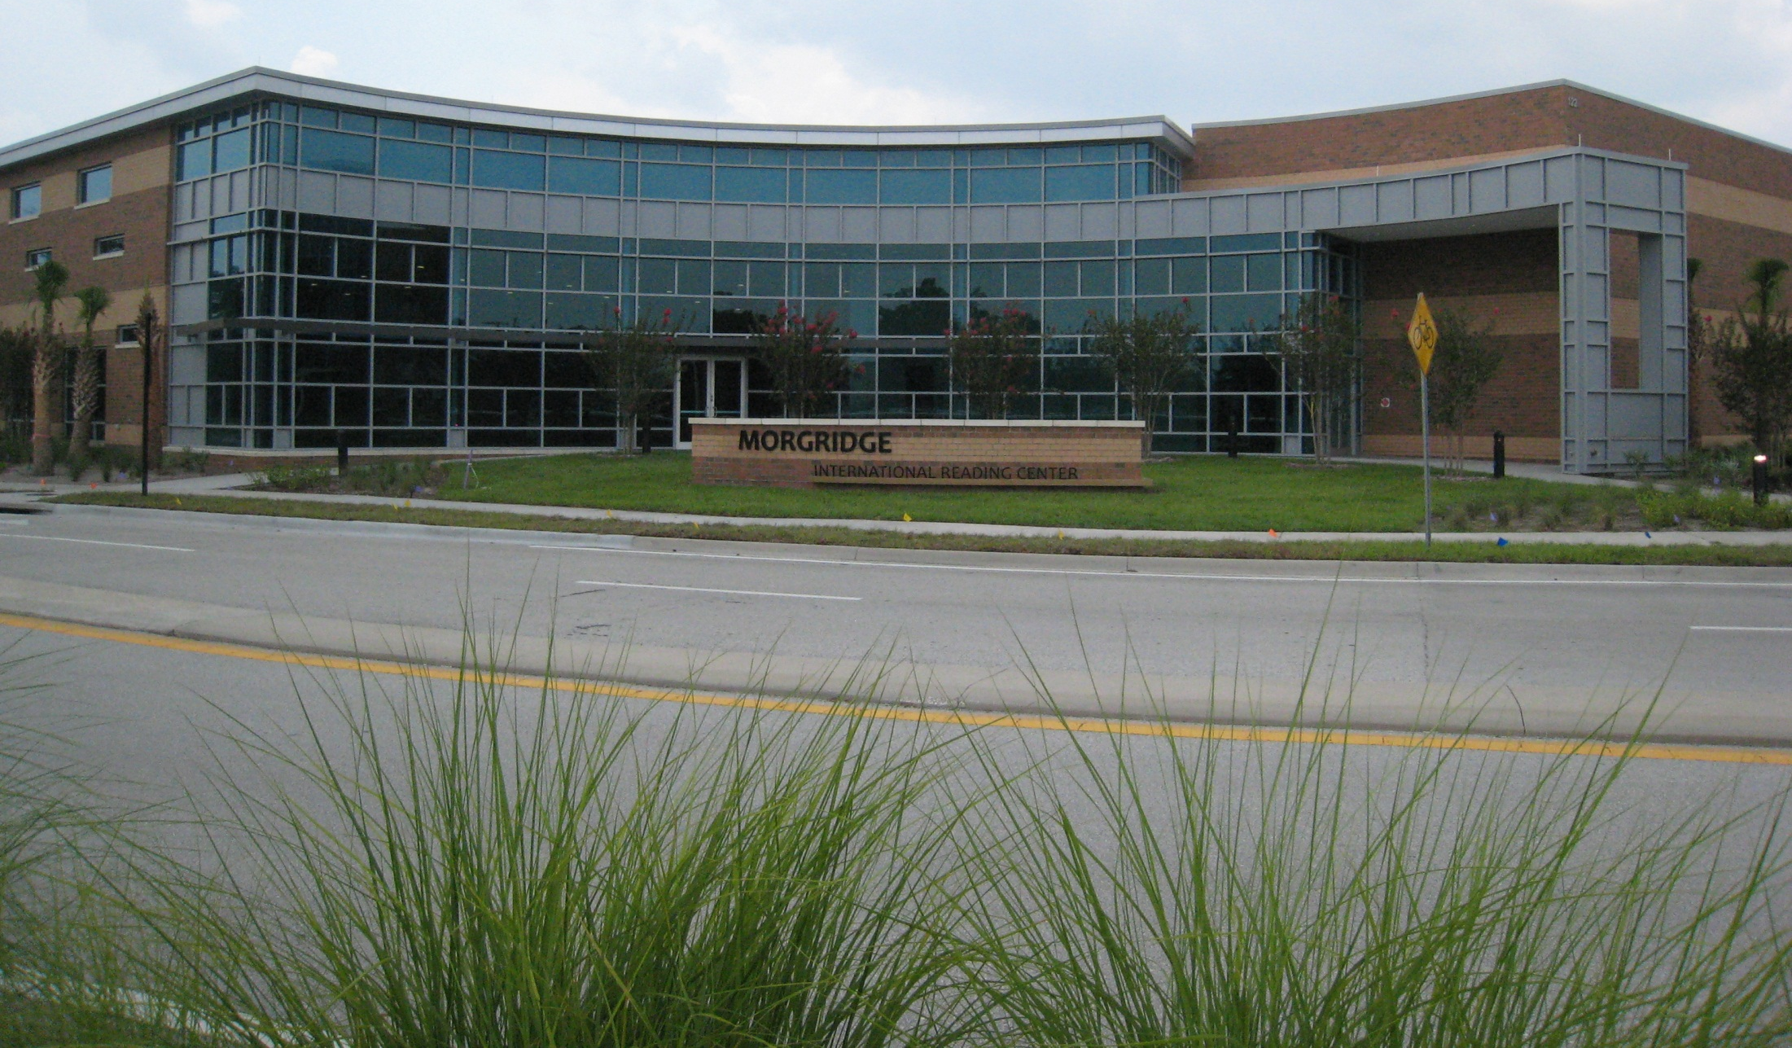
mirc.ucf.edu

