Slide 1
The selection of schools as site for Teaching Practice: conceptual dilemmas and strategic choices
Maureen Robinson
ICET World Assembly
Glasgow
July 2011

Slide 2
Teaching Practice placements
Organisational forms of TP vary
Important to understand substance of teacher education, not only structure
Different understandings of ‘suitable’ schools, depending on models of teacher education, historical and political location
Conceptual and strategic considerations of student teacher placements

Slide 3
Different contexts for the problem
Policy context
Social context
Quality assurance reviews
Models of teacher education

Slide 4
Policy context
“Teacher education is the kind of education which enables someone to become more competent in the practice of organising systematic learning and nurtures their commitment to do so” (MCTE 2004)
“Reflexively draw on integrated and applied knowledge so as to work flexibly and effectively in a variety of contexts” (DHET 2011)
Establishment of recognized Teaching Schools; functional schools in a variety of contexts (Int Plan)

Slide 5
Social context
Very wide gap between rich and poor
Poor results in national and international benchmark tests
Results linked to socioeconomic context

Slide 6
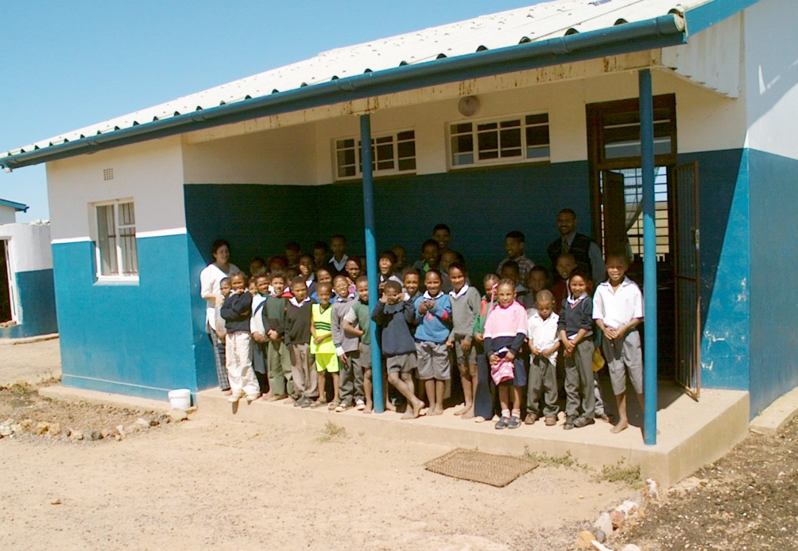
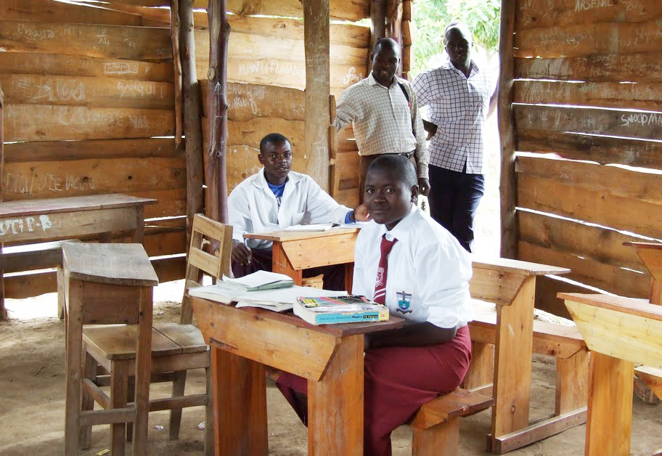
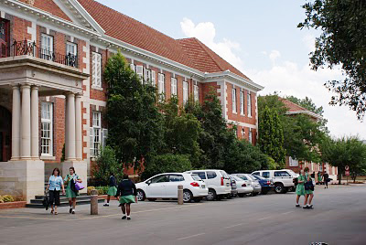

Slide 7
% of Grade 4(or 5 in SA) students below the low international benchmark (400) in PIRLS 2006
Notes:
7

Slide 8
Quality assurance reviews
Tension between the need for students to experience a variety of school contexts and the tendency to select schools according to the convenience of familiarity, transport and the allocation of tutors
Allocation of students to schools with committed and effective mentoring at times offset by a lack of exposure to contextual diversity
The absence of a coherent conceptual framework for teacher education

Slide 9
Models of teacher education (Sockett 2008)
Scholar-professional | Knowledge as the purpose of education; focuses on a rigorous understanding of the disciplines
Nurturer professional | Development of the individual; connected to nurturing and self-understanding
Clinician-professional | Research-based knowledge to inform practice
Moral-agent professional | Integrate academic content with intellectual and moral virtues

Slide 10
Models of teacher education (MCTE 2004)
Master-apprentice | Development of teaching competences through modelling the practices of an expert teacher
Applied scientist | Theory and principles applied to practice
Reflective practice | Students draw on their own and theoretical resources to consider situated problems
Critical reflective practice | Reflection oriented to understanding patterns of hierarchy and power and to becoming a change agent
Teacher identity | Each teacher has a lived experience that is connected to their personal biographies

Slide 11
An investigation of practice
The educational arrangements that constrain or enable the development of ‘public-good professionals’
Processes and criteria of selecting schools for TP
Challenges and dilemmas
How to make the selection more suitable to the goals of the programme and the needs of the students
Which of the conceptual models best described their own programme

Slide 12
Criteria for the selection of schools
Presence of subject or phase specialisation
Relationship with principal and willingness of school
Geographical location
Supportive environment
Functionality
(Good classroom practice)
Different social contexts
Who chooses?

Slide 13
Challenges, dilemmas, recommendations
Resource availability
Organisational factors
Student resistance to schools outside of comfort zone
Lack of formal mentor training or recognition
Relationship with schools too dependent on goodwill
The need to build firmer links with schools and provincial education departments

Slide 14
Value of the models in practice
Master-apprentice as most dominant
Models change for students over time
Applied scientist questioned by students
Different interpretations of teacher identity model

Slide 15
Working across a variety of contexts?
All teacher educators committed
Contained in official curriculum policy
Sticking points of implementation:
Institutional conditions
Policy condition
People conditions

Slide 16
Institutional conditions
Schools in poorer areas less likely to offer subjects, facilities, systematic mentoring; more likely to have classroom and social problems
Additional demands for support on university lecturers
High challenge and low support for students

Slide 17
Policy conditions
No formal policy or resources on mentoring places pressure on schools; more difficult where internal capacity is weak
No stipends for student teachers; difficult to move outside of their own residential areas

Slide 18
People conditions
“Emotionality” (Zembylas)
Anxiety about going to unfamiliar situations
Concerns about racism, language issues
Aspirations for own employment after graduating

Slide 19
Empirical value of the conceptual models?
Valuable as analytic devices
Limitations in context
Factors not encompassed:
Policy and resource parameters
Conditions of schooling
Students’ own histories, values, skills and dispositions

Slide 20
Conceptual limitations of models in respect of providing quality schooling for all
Master-apprentice | Implicit expectation of attending ‘good’ schools
Applied scientist | Assumes a normative context of schooling and a linear relationship between theory and practice
Reflective practice | Not enough attention to expert role models
Critical reflective practice | May be de-linked from students’ own material interests
Teacher identity | Can preclude entering new emotional and social territories

Slide 21
We need a conceptual model of teacher education that explicitly promotes pedagogical excellence as a form of social justice in difficult educational contexts
Learn in practice
Learn about practice
Learn in spite of practice

Slide 22
Develop a way of talking about teacher education that incorporates learning good practice as well as contributing to quality schooling for all
A conceptual model that talks to individual professional growth as well as the public good

Slide 23
Way forward?
Capability theory? (capabilities and functionings)
Connections between pedagogical content knowledge and emotional knowledge of students
Teacher education curriculum
Policy conditions on teachers’ work

